Slide 1






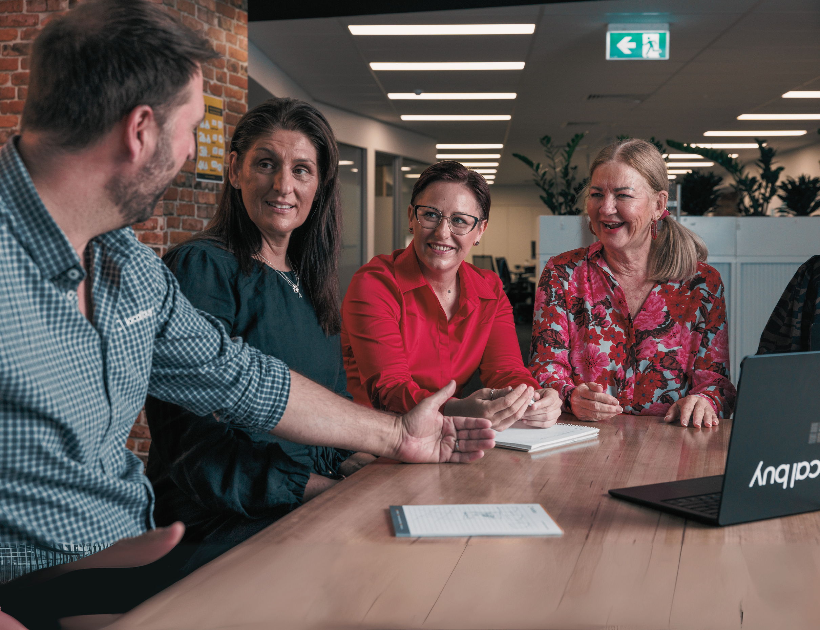

Advancing Queensland Procurement
Local Buy Introduction
August 2025

Slide 2


Who is Local Buy?
Local Buy is a wholly owned subsidiary of the Local Government Association of Queensland (LGAQ).
Created in 2001 to assist councils streamline procurement.
A profit-for-purpose organisation we return all profits to LGAQ who use these funds to provide member services to Queensland Councils.
Advancing Queensland Procurement
Notes:
😊 As many of you know, Local Buy is Queensland’s principal local government procurement partner and the largest provider of legislatively compliant pre-qualified supplier arrangements in the state.
Our goal is to make it easy, efficient, and effective for local government organisations to connect with their suppliers.

Slide 3


Queensland Default
Procurement Rules
Advancing Queensland Procurement
Medium
$15,000-
$200,000
Large
>$200,000
Thresholds are accumulative, for the life of a contract or a Financial Year with a Supplier for similar goods or services.
Council must obtain three written quotes
Council must perform an open market tender
Local Government Regulation 2012
Part 3 – Default Contracting Procedures
Notes:
EM
Talk about the Thresholds set down in the Regs
- officers act on behalf of councils – they must adhere to the rules and regulations outlined in the legislation

Slide 4
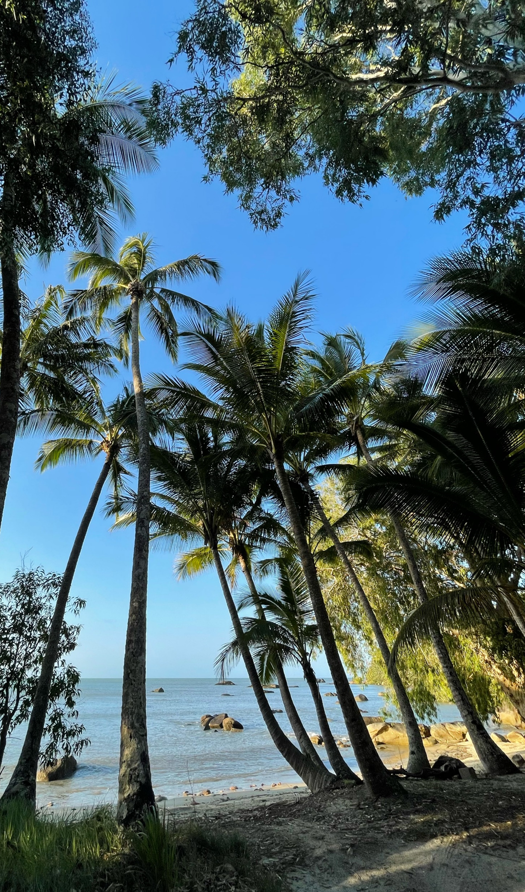
Using Local Buy = No Tenders
How do we do that?
Local Buy has the legislative right to establish Arrangements that are compliant with the Local Government Regulations 2012. Local Buy Arrangements are an exception under s.234 of the Local Government Regulations for purchases of any size.
Local Buy Arrangements are considered tendered, and councils can use them for $1 - $100m+ without conducting their own tender.
Council's and government authorities can purchase a broad range of products and services from prequalified/preferred suppliers, without needing more complex quotation or tender processes.

Slide 5
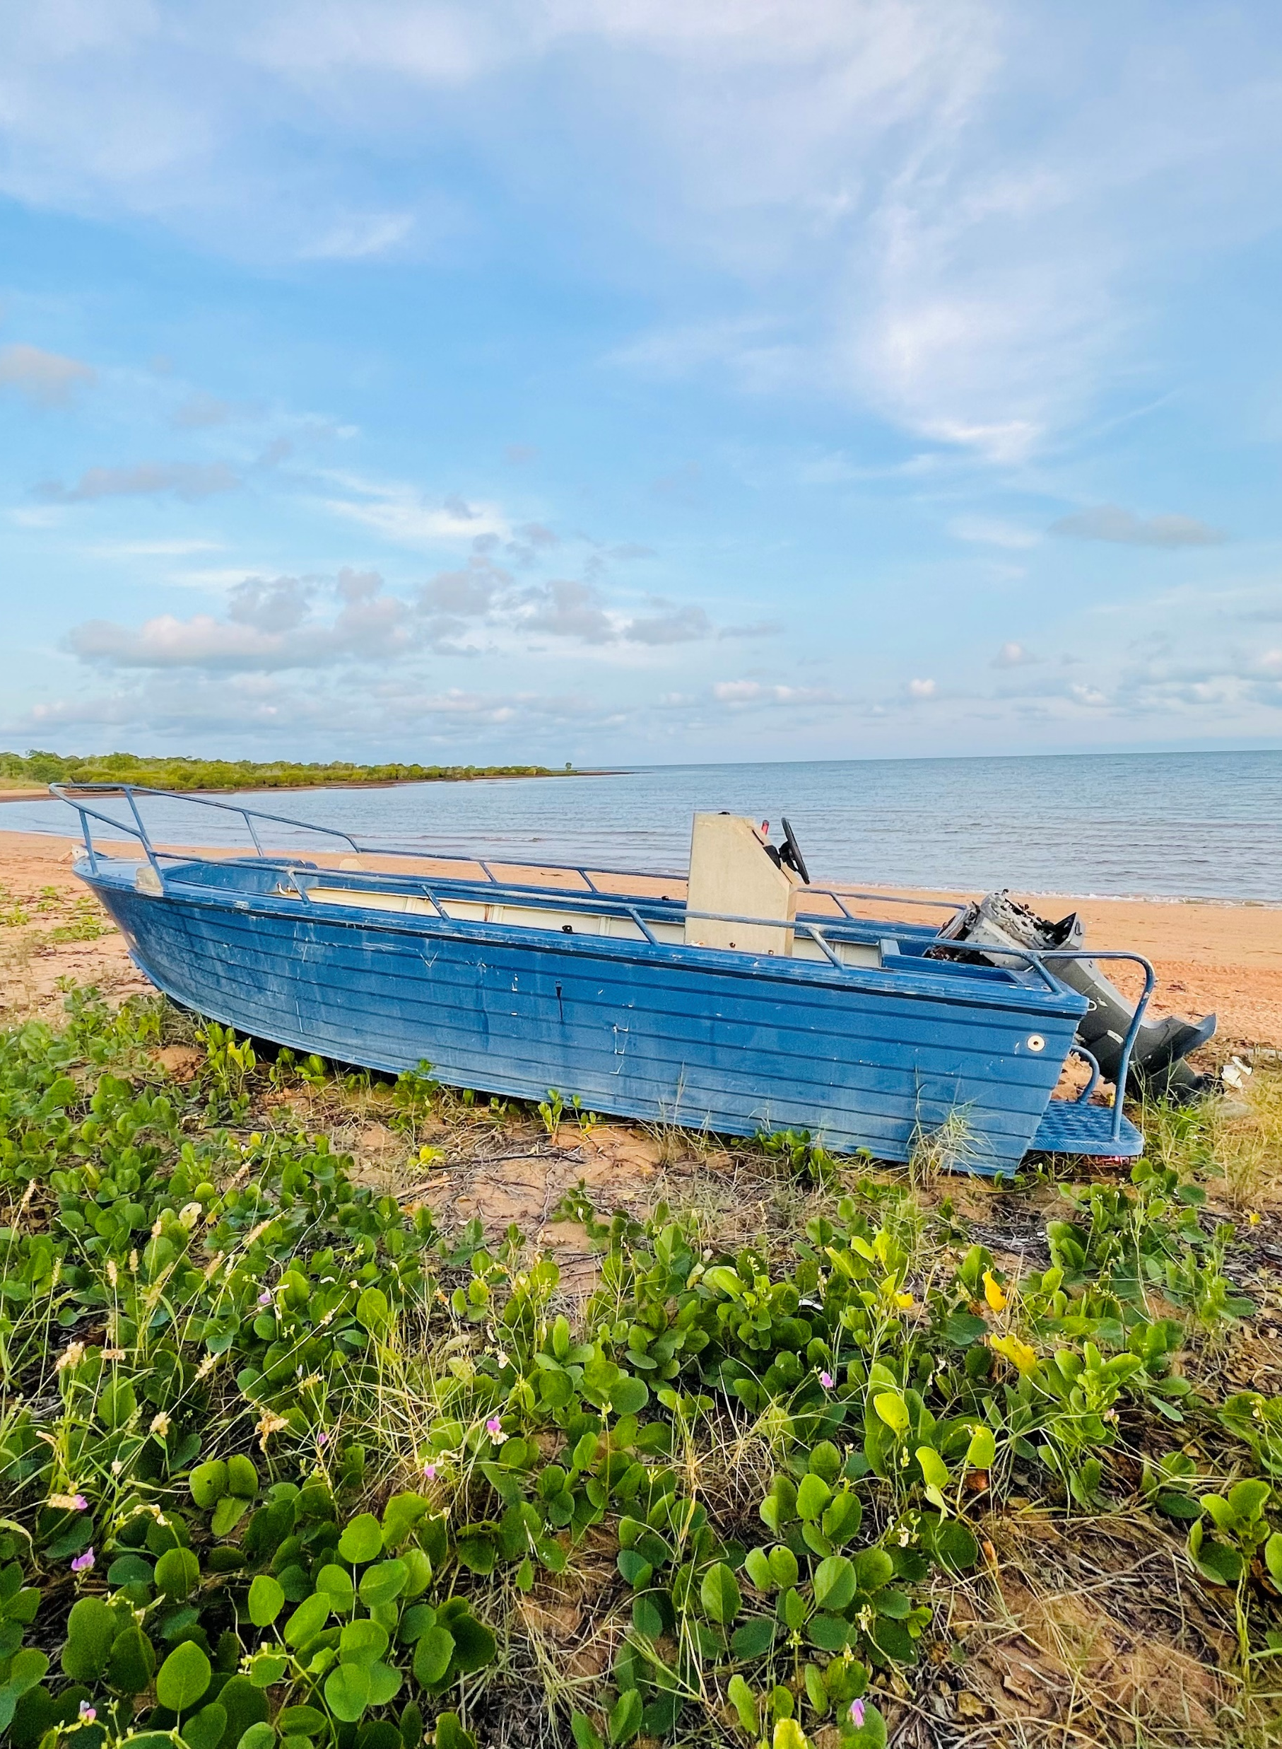

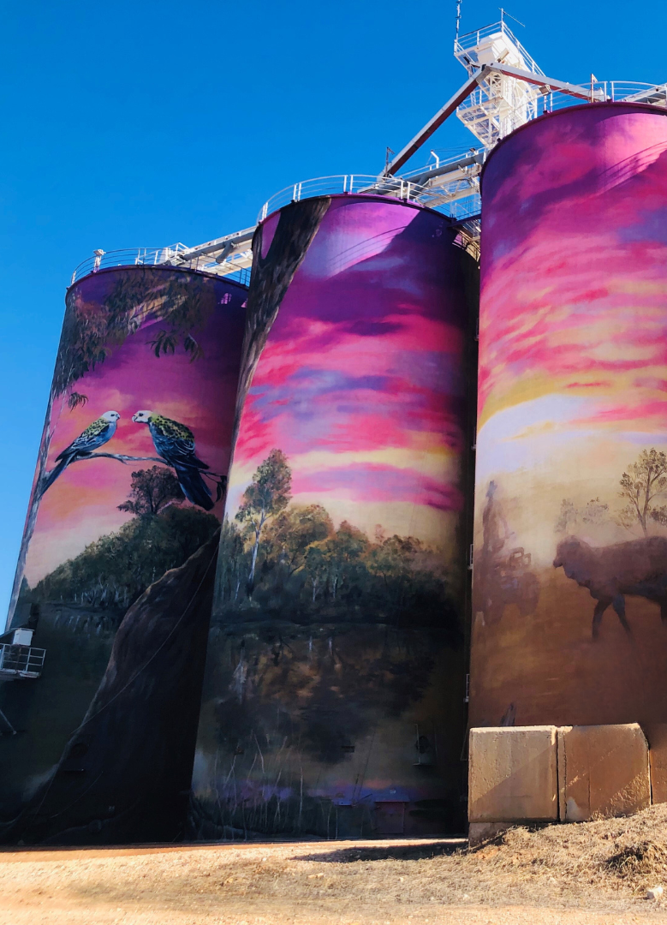

Who can use Local Buy Arrangements
Local Government Entities
Queensland State and Federal Government Departments
Queensland Community Councils
Queensland Regional Organisation of Councils (ROCS)
Queensland Statutory Authorities and Bodies
Government Owned Corporations (GOCs)
Water Authorities and Ports
Charities and Not-For-Profits
Educational Organisation’s (Schools & Universities)
Other Local Governments interstate who are party to our header agreement
Our arrangements are trusted and used by all 77 Councils in
Queensland. They are also accessible by various other organisations including Universities, State Government, and Utilities.
Notes:
Trusted by all 77 councils in QLD
Other local government entities use LB
State and Federal departments also use LB

Slide 6
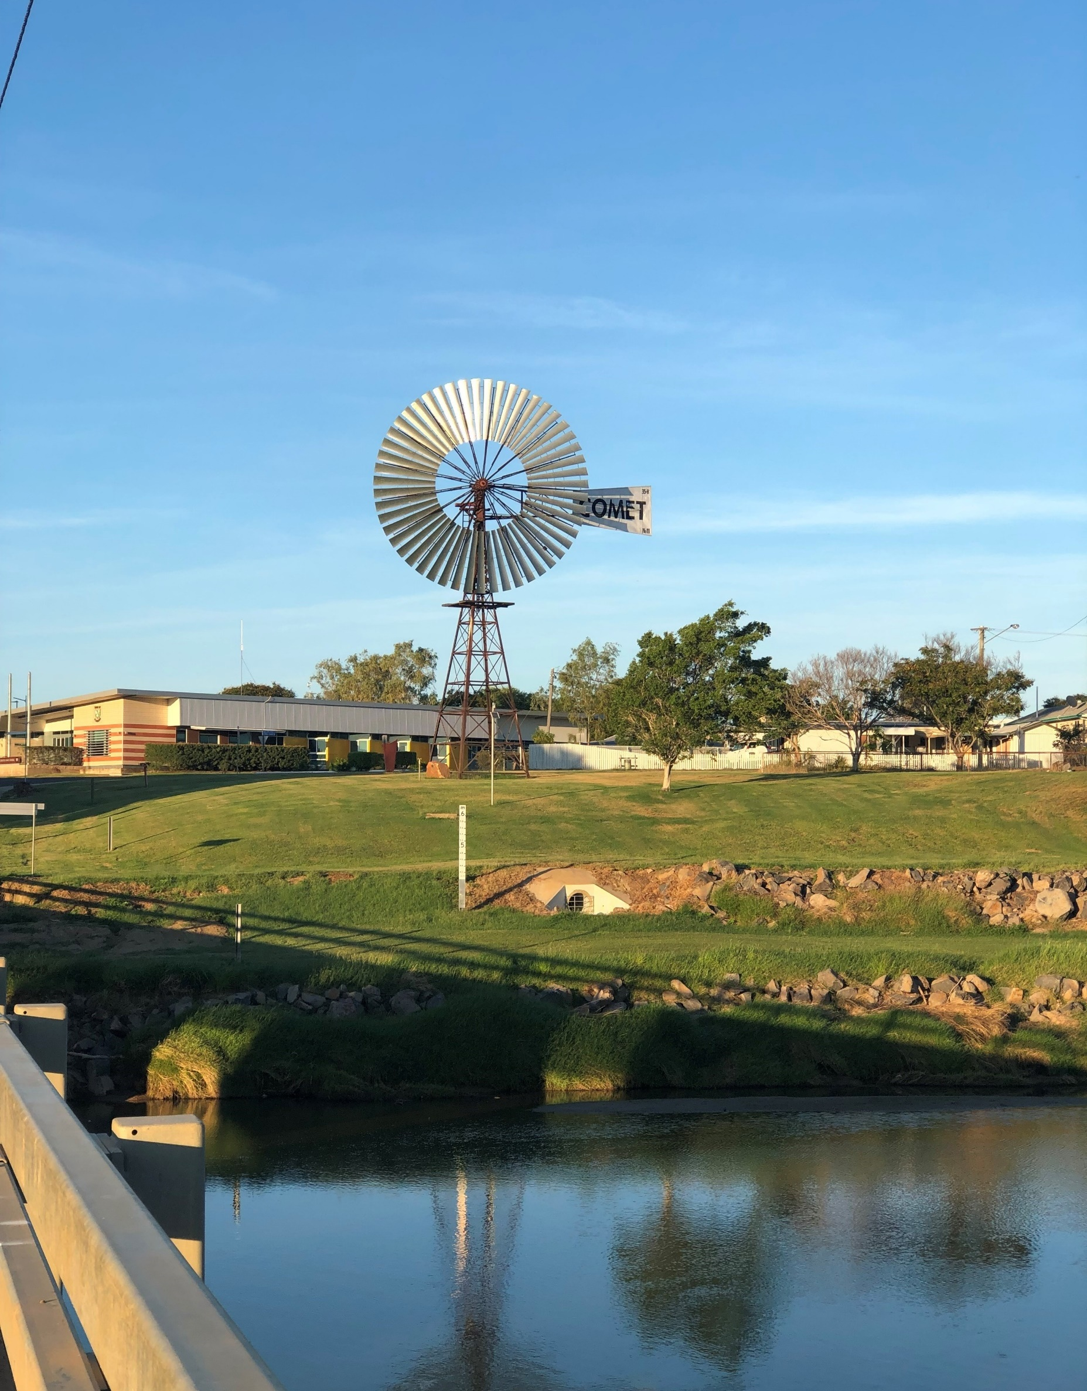

Why suppliers like Local Buy?
The benefits of Local Buy:
Access to a large Local Government market
Reduces cost to tender
More likely to win the work with faster contract awards
A pathway to repeat business with key customers
Local Buy enables councils to connect with valued suppliers who understand Local Government.
Notes:
Em
Read through Dot points expanding upon them

Slide 7






Status & performance
Year at a glance:
1,217
individual purchasers
Every Queensland Council uses Local Buy
Local Buy has 51 Arrangements across seven broad portfolios:
279
purchasing organisations
4,130
pre-qualified suppliers
Corporate Services & Equipment
Fleet
$1B
in spend
Libraries
Planning, Waste & Open Spaces
12%
ICT & Telecommunications
Electricity
increase in the use of Local Buy
Construction, Roads & Engineering
47%
of all Local Buy RFQs go through VendorPanel

Slide 8
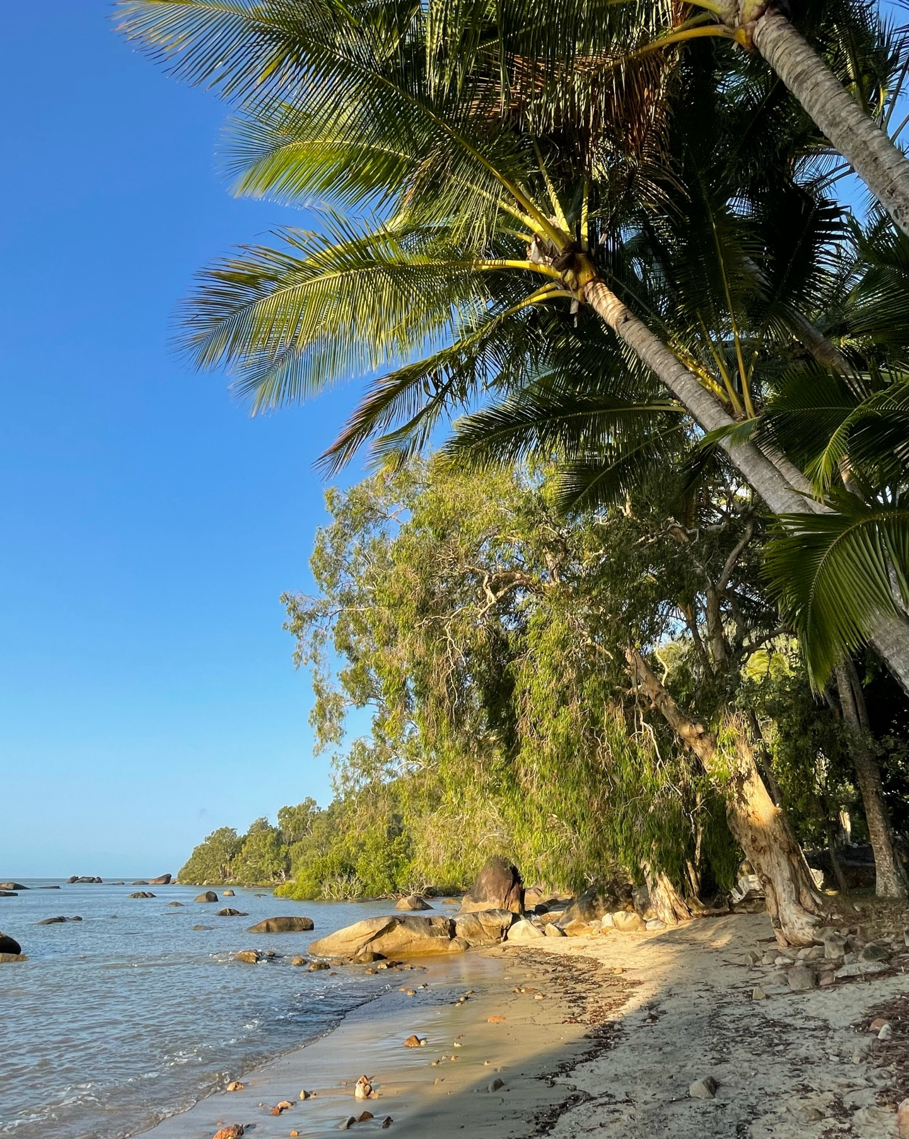

Current Portfolios – 51 Arrangements
Industrial commodities & services
Building & Construction Supplies​ LB298
Electrical & Lighting Supplies​ LB299
Fire & First Aid Supplies, Equipment & Maintenance Services​ LB296
General Hardware Supplies​ LB293
Landscape, Gardening & Arboriculture Services​ LB305
Public Facilities, Parks & Amenities​ LB304
Quarry Products & Geosynthetics LB341​
Sport & Recreational Facilities & Equipment​ LB303
Veterinary Services and Consumable​ LB319
100’S of
Sub-categories and growing!!

Slide 9
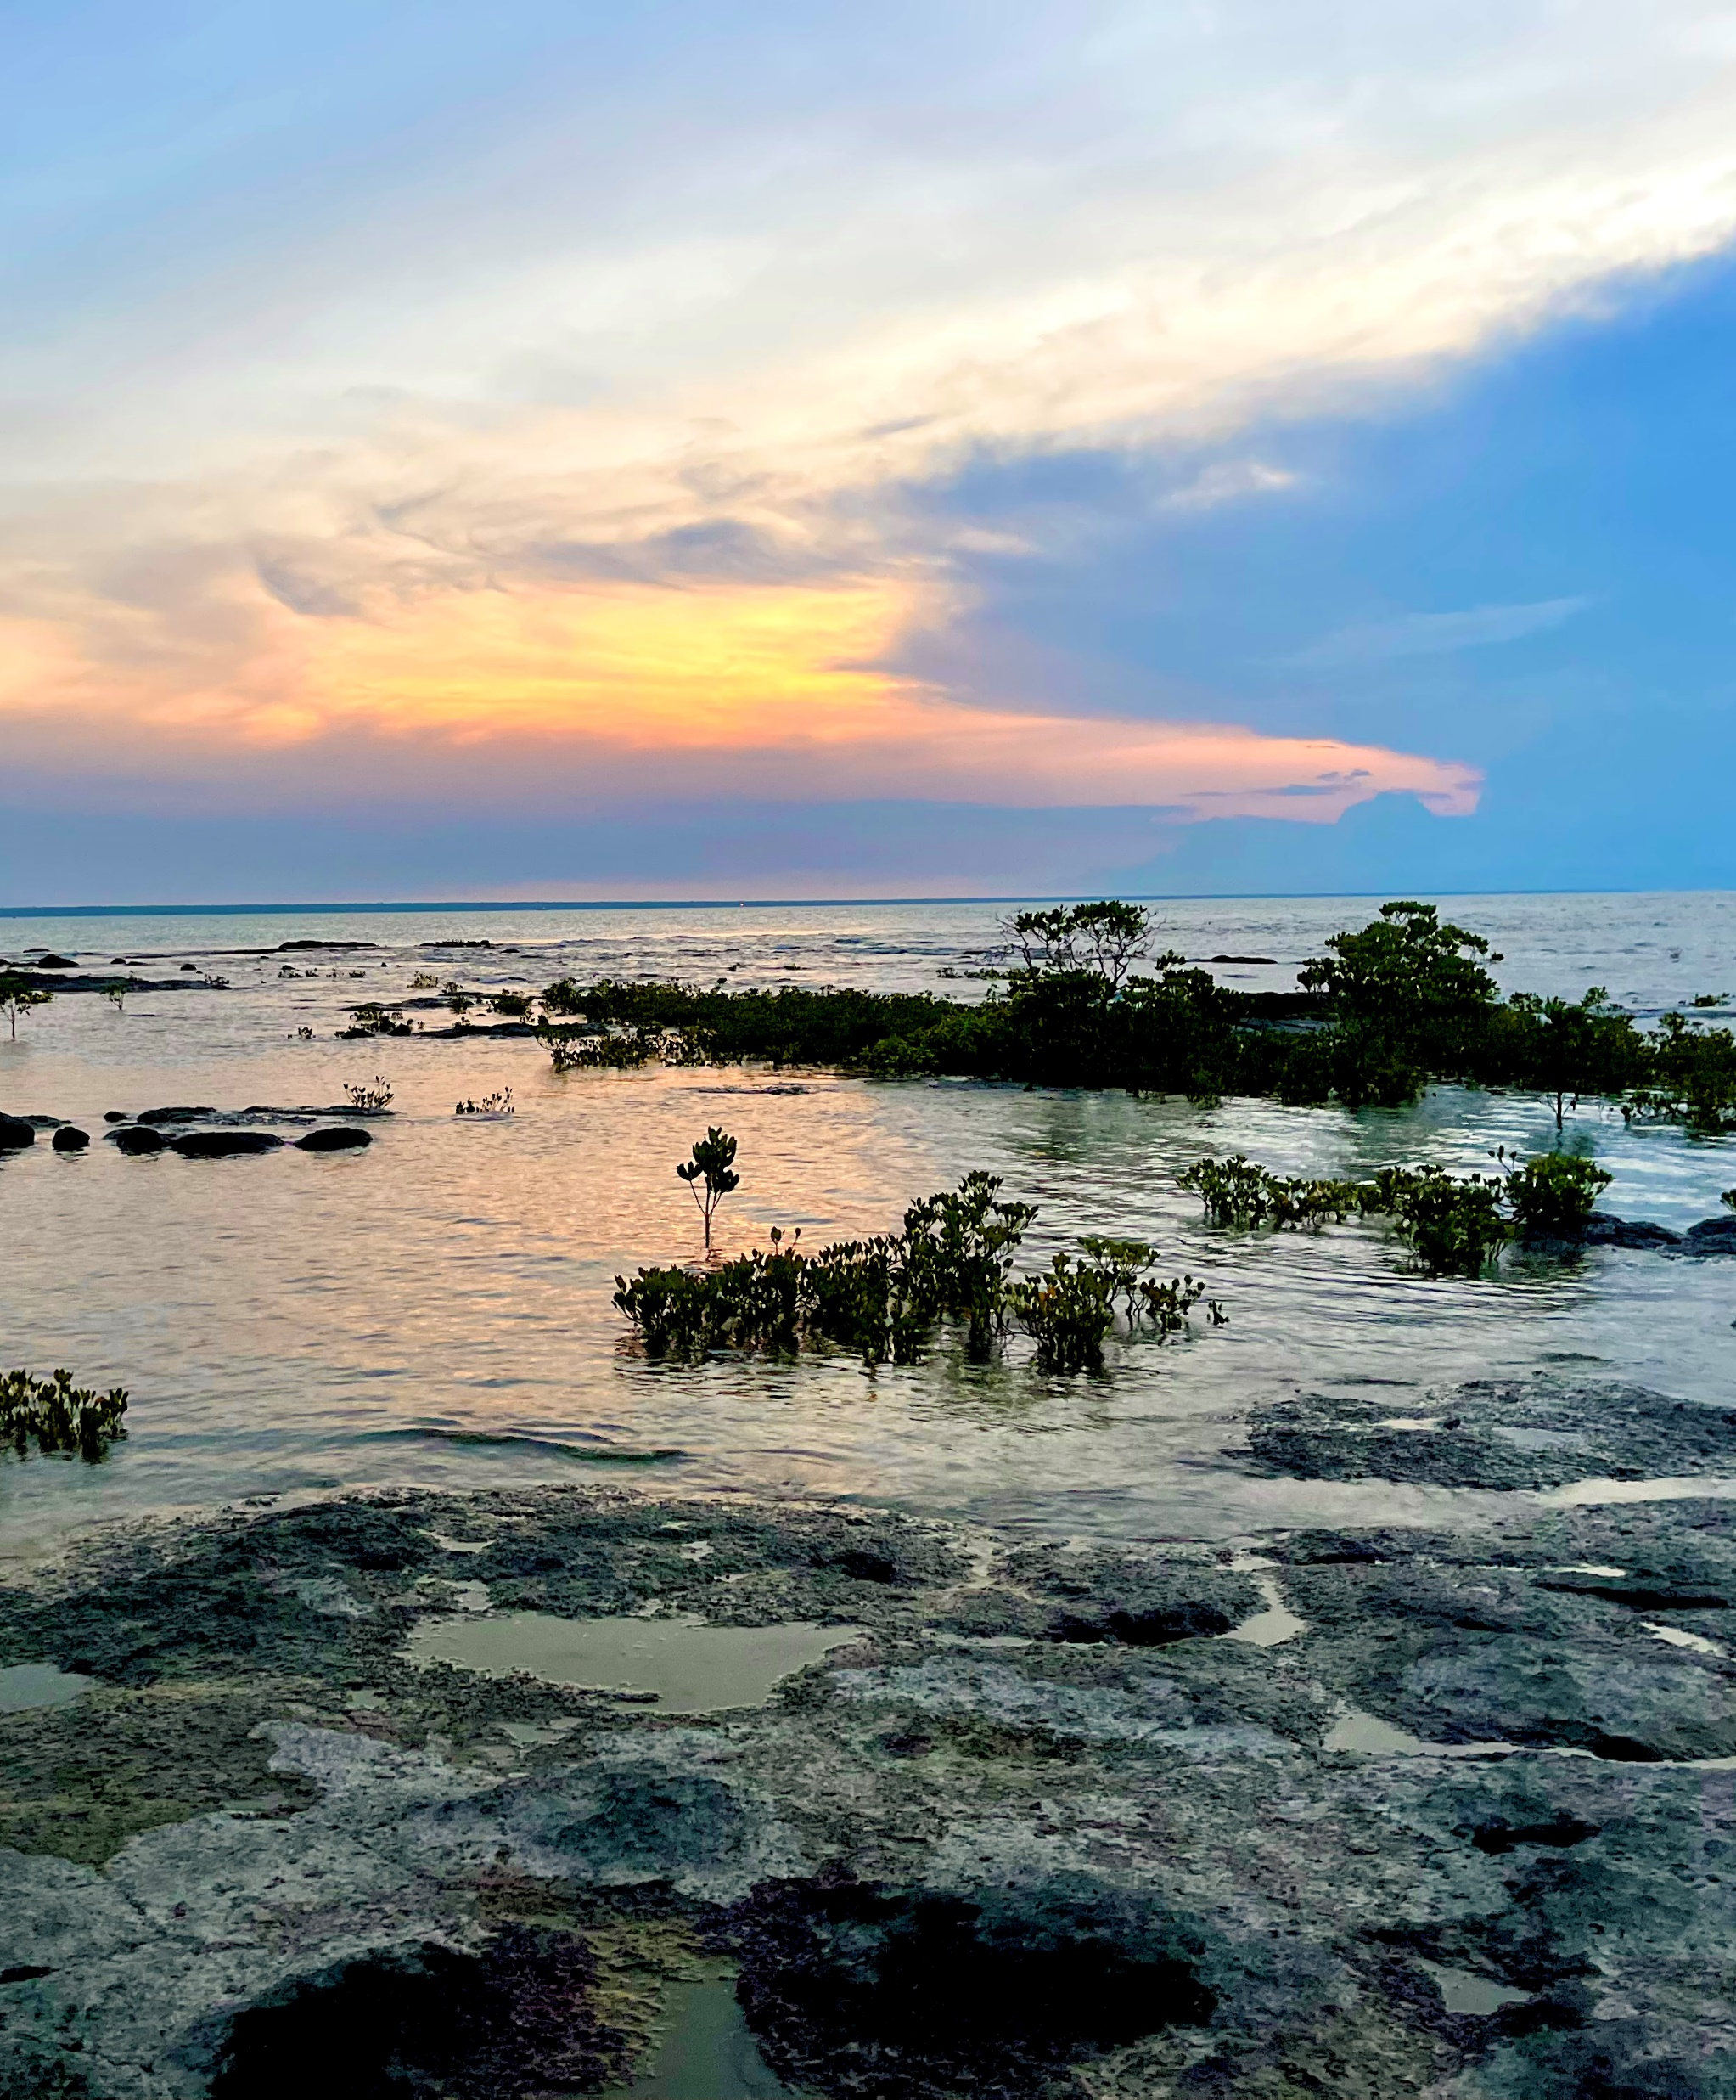
Current Portfolios – 51 Arrangements
Corporate equipment & services
Business Management & Consulting Services LB309
Corporate Clothing, Workwear & PPE LB307
Event Equipment Hire Services LB294
Event Management Services LB292
Financial Management Services LB310
Marketing, Media, Print Services & Promotional LB306
People & Wellbeing Services (Human Resources) LB328
Recruitment: Managed Service Providers (MSP) LB336
Recruitment Services – Permanent Staff LB297
Recruitment: Temporary and Labour Hire Services LB334
Security Services, Equipment & Maintenance LB289
Stationery & Janitorial Suppliers; Office Furniture; Office Machines, Equipment & Accessories LB285
Training Services LB327

Slide 10
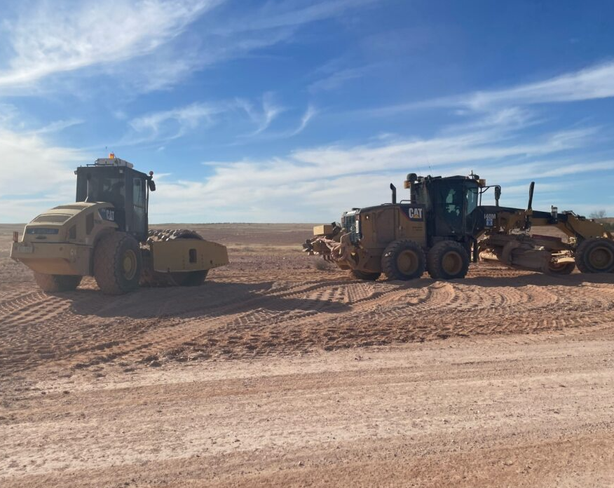

Current Portfolios – 51 Arrangements
Fleet & field equipment
Bulk Fuels LB321
Bulk Fuel & Oil Storage Tanks & Dispensing Equipment LB324
Fleet Charge Cards LB322
Fleet Management Services LB281
Heavy and Light Plant Machinery LB345
Motor Vehicles and e-Mobility Vehicles LB320
Oils & Lubricants + AdBlue LB323
Plant & Equipment Dry Hire LB301
Spare Parts & Associated Services LB318
Trailers, Tankers & Truck Bodies LB286
Trucks, Buses, Specialised Trucks, Bodies & Trailers NPN1.23
Tyres, Wheels and Associated Services LB317

Slide 11
Current Portfolios – 51 Arrangements
Civil infrastructure, works & asset management
Asset Management Services LB280
Building & Construction – Commercial Construction & Fit Out (inc: Asbestos and Demolition) LB329
Building & Construction – Residential LB331
Chemical Supply LB337
Mobile Garbage Bins (MGBs), Industrial Container & Bins, Static Compactors, Associated Products & Services NPN1.11-4
Planning, Surveying, Design & Architectural Services LB335
Project Management Services (Civil Infrastructure) LB279

Slide 12
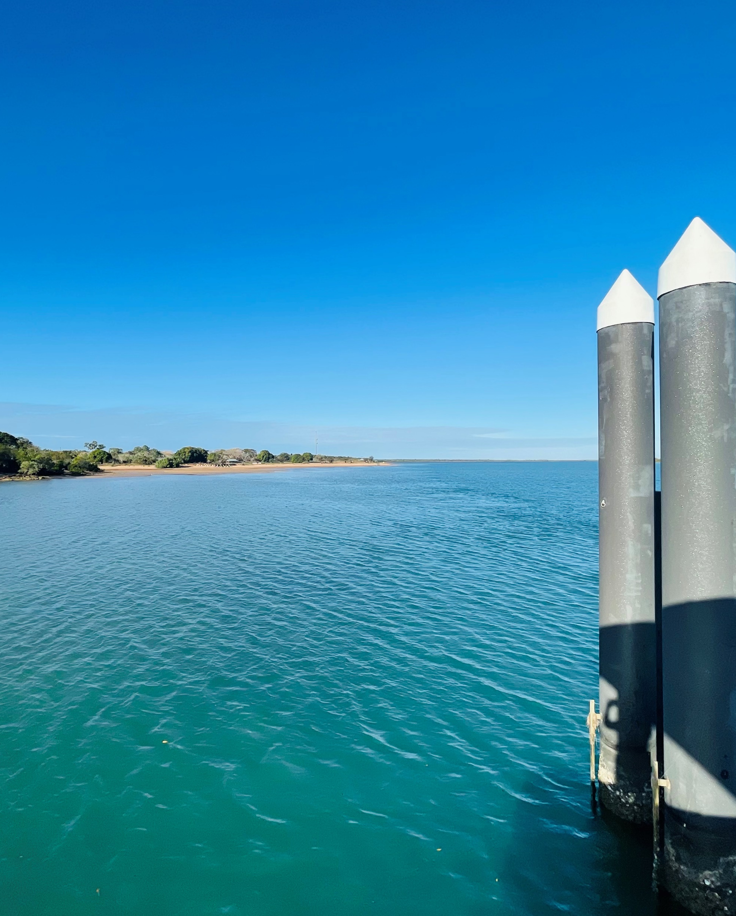
Current Portfolios – 51 Arrangements
Engineering & environmental
Engineering & Environmental Consultancy Services LB312
Road Furniture & Signage Products LB315
Road and General Civil Construction LB313
Traffic Management Services LB325
Water, Sewerage & Stormwater Infrastructure LB314
Water, Sewerage & Stormwater Products LB316

Slide 13

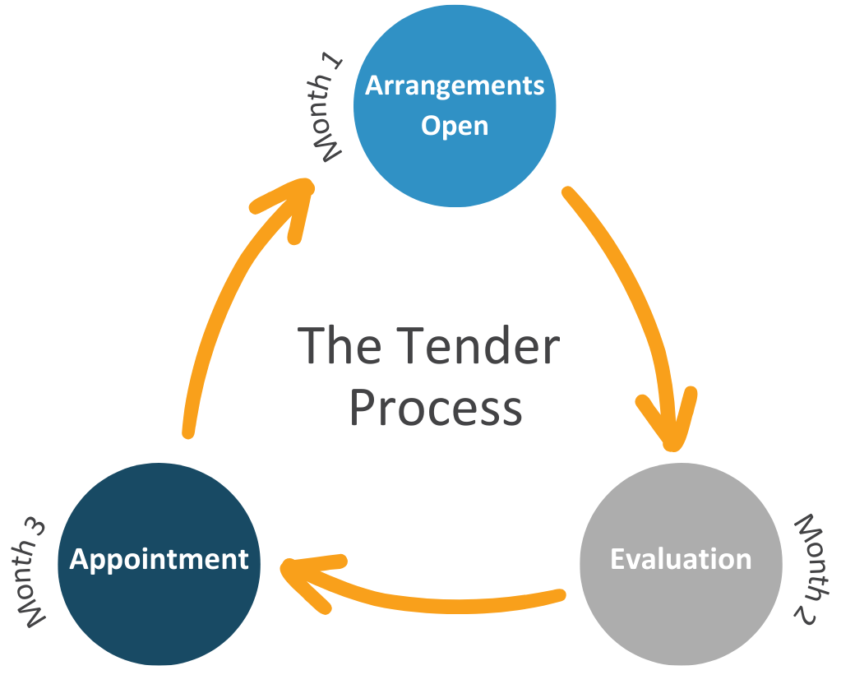

Our Arrangements are different
CIPS ANZ award winner 2024
“Best Procurement Transformation and Change Program”
The majority of Local Buy LGA Arrangements open every 3 months in February, May, August, and November.
Local Buy is the FIRST and ONLY organisation to open tenders this frequently! This provides potential suppliers with more opportunities to get pre-qualified and win work with local governments and other entities.
Our pre-qualified Suppliers are the backbone of our organisation.
Growing supplier base.
Agile in response to changing market needs or new businesses.
Easier for regional and small businesses to apply.
Notes:
Read the pertinent month

Slide 14


Website
Advancing Queensland Procurement
Advancing Queensland Procurement
localbuy.net.au
TENDERS NOW OPEN
1st August to 29th August 2.00pm AEST
Notes:
Visit the events calendar on the LB website.

Slide 15

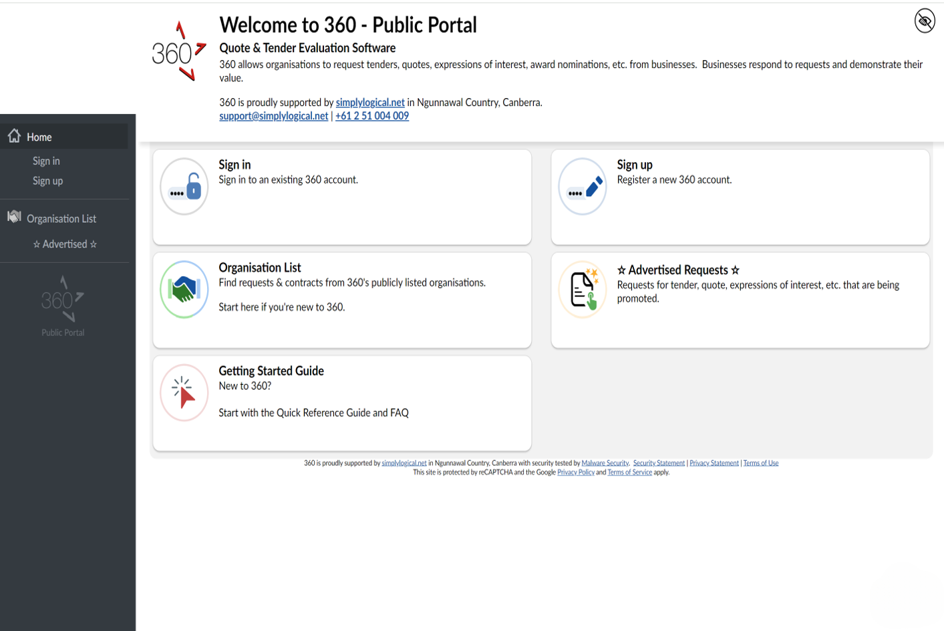
360 Providers
Advancing Queensland Procurement
360 is the tender portal Local Buy uses to receive your tender submission for our LGA Arrangements
You will be prompted to create an APET360 account if you have not done so, and it is completely free to register.
Every question needs a response!
Answer every question!
Read every addendum.
The "Final Step" will not let you submit
until everything is complete.
https://360providers.apetsoftware.
com.au/request/open/localbuyrft
Local Buy cannot see suppliers’ responses until the request has closed (this assists evaluation teams reach their decisions using fair and equitable systems).
Notes:
We will be composing a Webinar in “How to complete your Local Buy Tender Response” in the coming weeks.

Slide 16

Important Documents
Default Purchaser Conditions of Contract (PCCs)
General Conditions of Contract: The contract between the supplier and Local Buy.
Specification: The technical information about the arrangement.
Purchaser Conditions of Contract: The contract that is used when a purchaser engages a supplier through a Local Buy arrangement.
Please ensure you read these documents thoroughly!

Slide 17

Minimum insurance levels required (specific to each Arrangement)
Advancing Queensland Procurement
Spend via Local Buy Arrangement
$115 million last fin year
Part of Local Buys process is to ensure a base-line level of insurance (determined on the arrangement, category and level of risk) is applied. This base-line level of insurance is what councils typically require.
The below amounts are general and vary from contract to contract so you will need to refer to Schedule A of the GCCs.
Public Liability Insurance: $20 mil
Product Liability: $20 mil
Professional Indemnity Insurance: $2 mil
Statutory Workcover Insurance
COURTESY OF ROCKHAMPTON REGIONAL COUNCIL
Notes:
Minimum insurance levels vary from Arrangment to Arrangement – please refer to Schedule A of the GCCs for the specific rates.
You will be asked to upload your insurances 1-2 weeks after you have submitted your tender. This is not an acceptance of your tender submission being successful, but simply to make the process more efficient should you be successful.

Slide 18
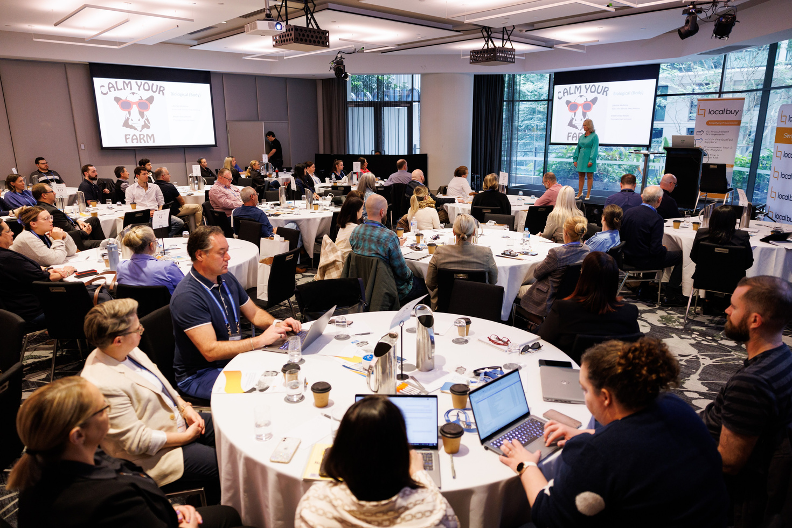
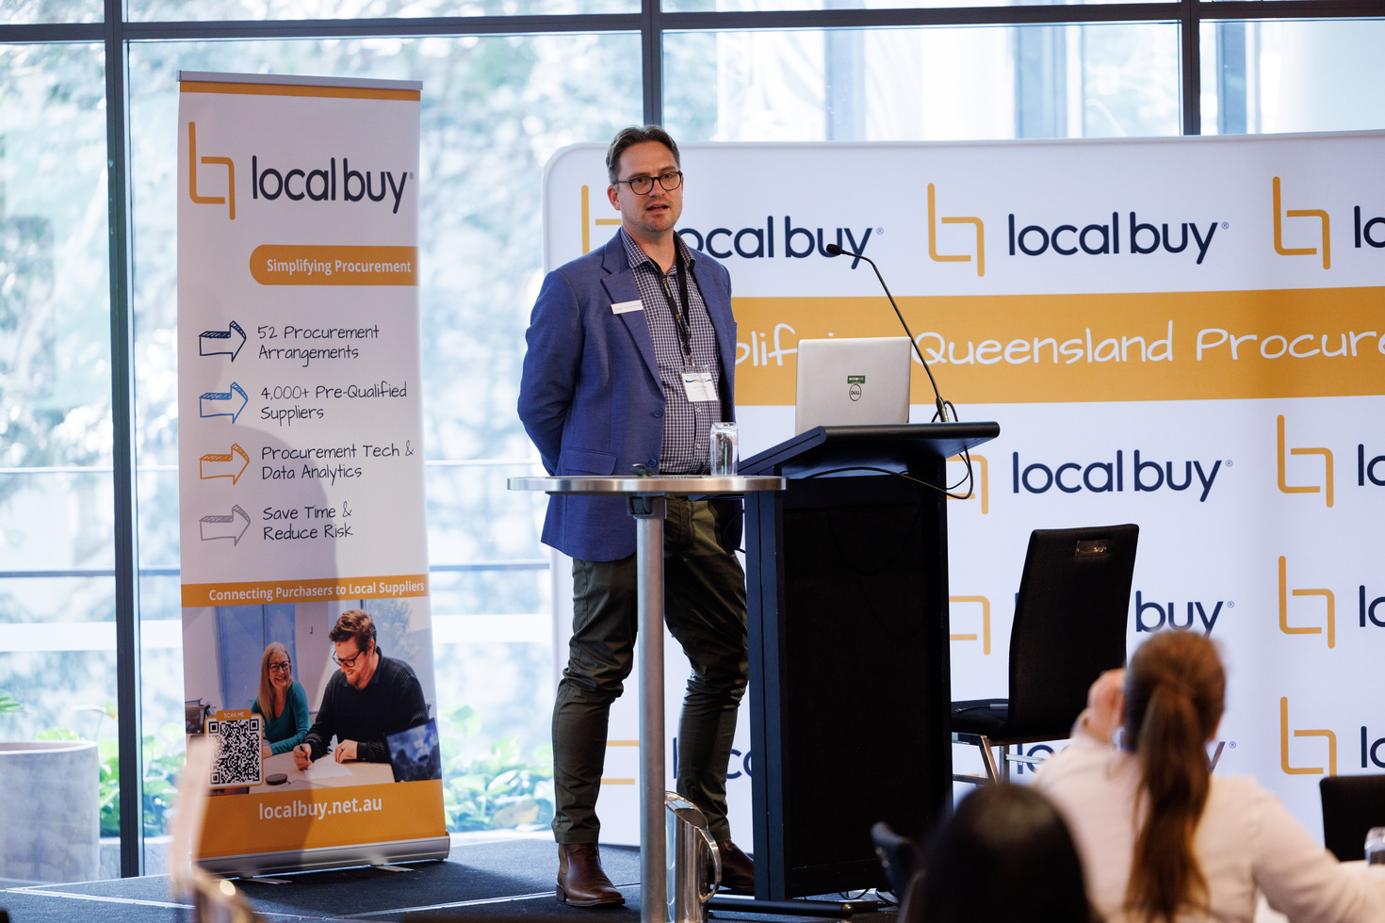
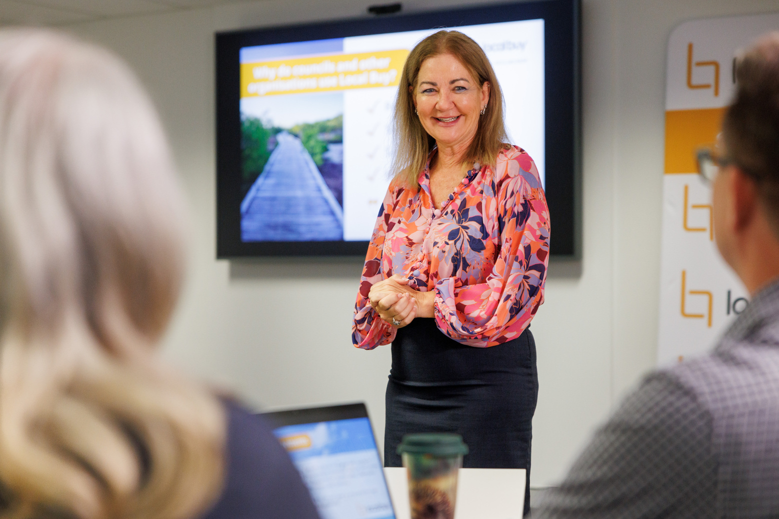
Quality Assurance, WHS & Environmental
& Mandatory Requirements
During the tender process, you will be required to provide details of your Management
Systems in relation to:
Quality Assurance
Workplace Health & Safety
Environmental
Certification & Compliance:
  ISO or AS/NZS certification is desirable
  Must comply with relevant industry standards, codes of conduct, or ethics
Purchaser Expectations:
  Outline management system requirements in RFQ documentation
  Membership in relevant industry bodies or associations is highly regarded
  Suppliers are responsible for staying current with industry standards and regulations
Capability
If applicable, you will be required to demonstrate your capability in the relevant category of the arrangement you are tendering for. This can include examples of previous work that showcase your expertise. A template will be provided for guidance and your use, or you may upload your own document.
Notes:
Read dot points only

Slide 19
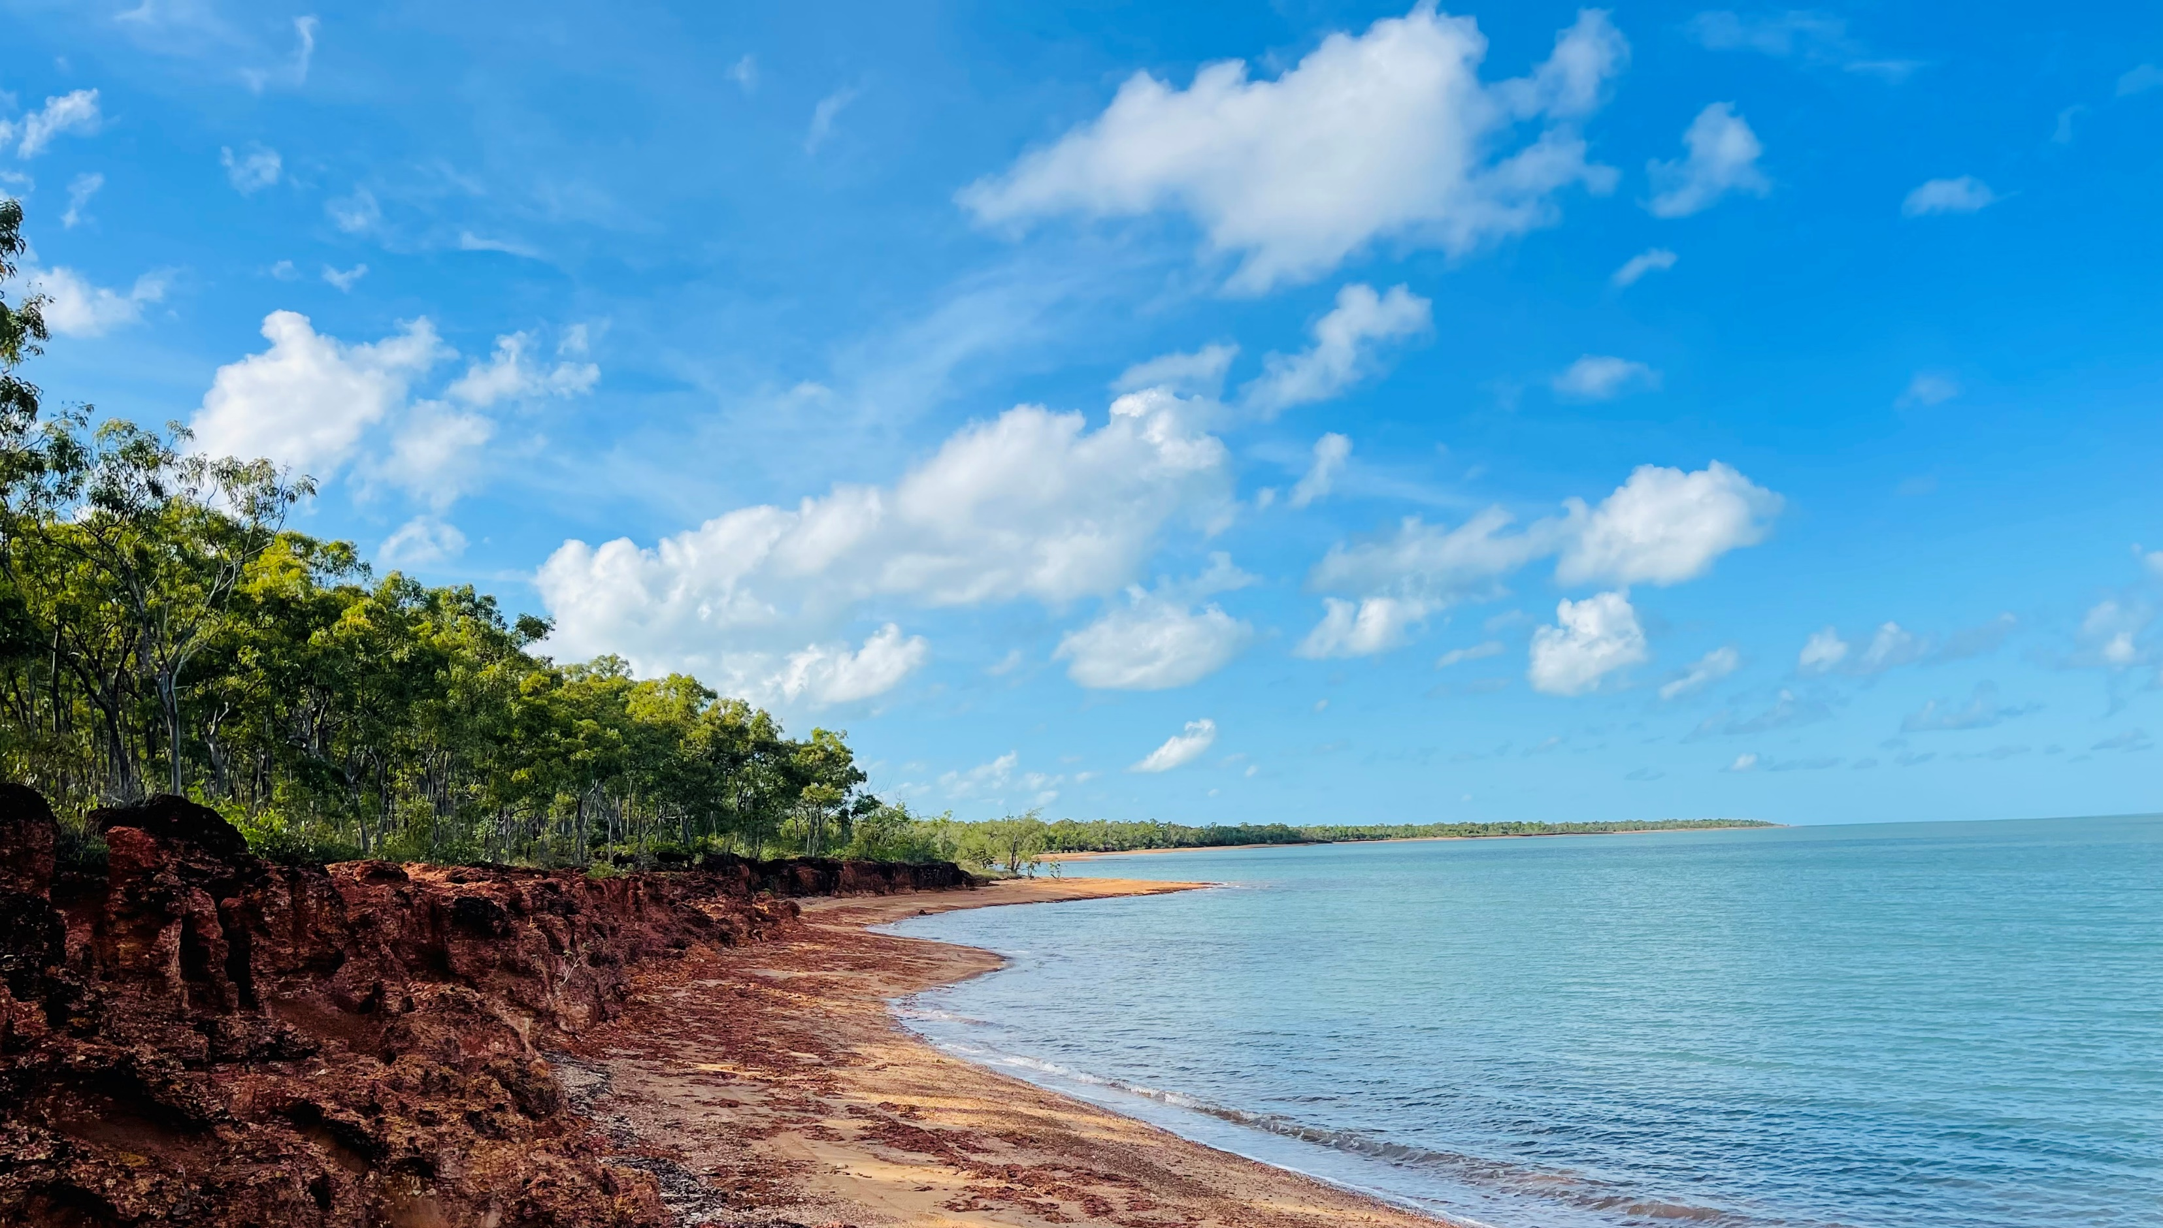
Verification Fee
Local Buy’s fee structure (unless you hold a valid exemption) is set below and is also included in Schedule A of the General Conditions of Contract. All new Suppliers (i.e., are not a Local Buy pre-qualified Supplier at the time of tender) are required to pay the supplier Verification Fee before their appointment to any Arrangements unless an exemption applies.
The Verification Fee does not apply for Legal Services (Goods & Services) LB311; Motor Vehicles and e-Mobility Vehicles LB320; Quarry Products & Geosynthetics LB341 and NPN prefix Arrangements, as these LGA Arrangements are structured differently.
Initial Verification Fee:
$500 (ex GST) payable on the Contract Commencement Date by new Suppliers, $250 (ex GST) for current suppliers.
Annual Verification Fee:
$250 (ex GST) payable annually by all Suppliers.
Any variation to this fee structure is outlined in Schedule A of the General Conditions of Contract.

Slide 20
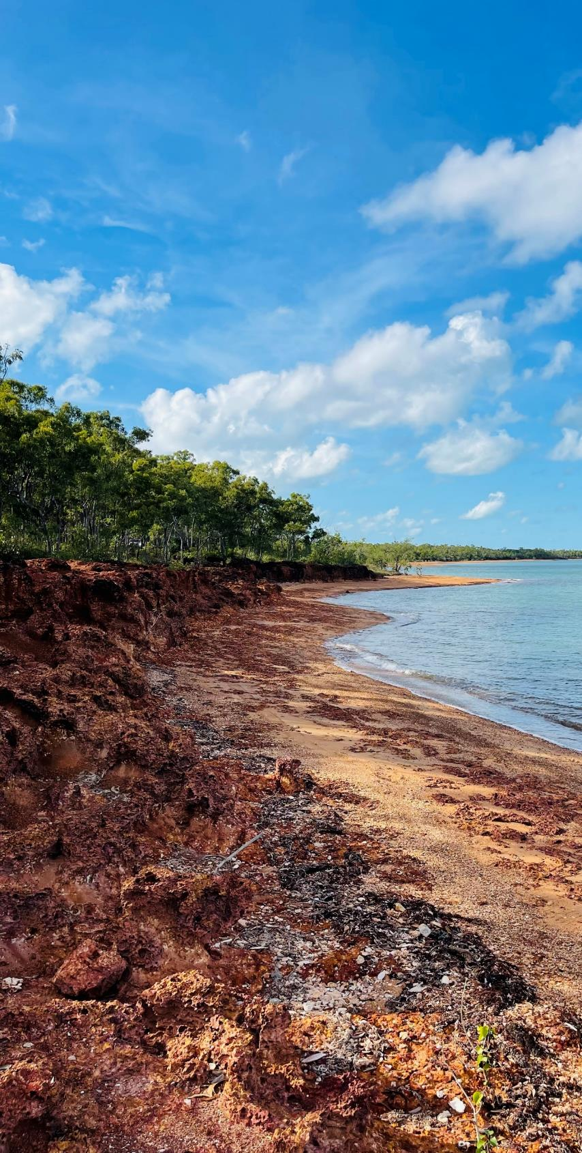
Verification Fee Exemption Eligibility
Local Buy supports small businesses
Exemption 1
Have a registered head office in Queensland, Tasmania, or the Northern Territory;
AND
Be a Sole Trader (as confirmed via ASIC)
OR
A Small Business (which is defined as a business that has an annual turnover of less than $500,000 per annum in the previous financial year, you will be required to provide a copy of your business financials in the previous financial year or a letter from an accountant, confirming turnover was less than $500K);
Exemption 2
A registered charity with the Australian Charities and Not-for-profits Commission (ACNC).
OR
A registered indigenous businesses with Supply Nation or Black Business Finder.
OR
A registered social enterprise with Social Traders.
All new Suppliers are requested to submit their exemption declaration at the time of tender, however, failure to do so will not prevent an appointment to a Local Buy Arrangement.

Slide 21
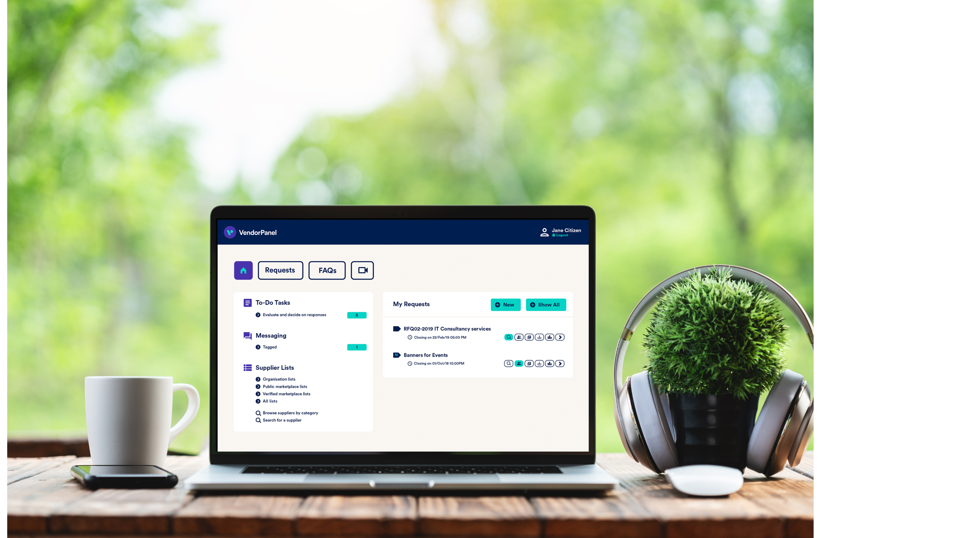
Vendor Panel
Advancing Queensland Procurement
VendorPanel is an online electronic RFQ system accessible through Local Buy by both the Supplier and Purchasers. Once registered you will then appear in VendorPanel “Marketplace”.
https://www.vendorpanel.com.au/marketplace.aspx
Marketplace is not a pre-qualified list of suppliers. Whilst some of your businesses may also be listed on Marketplace, unless engaged under the Local Buy Arrangement number, buyers are not covered by T&Cs Local Buy contract or legislative exception.
Notes:
Read as above but make mention of “Monthly Reporting” and other obligations as a Local Buy Prequalified Supplier will be covered in the “New Supplier Welcome” should you be successful.

Slide 22


Contract Management Fee (CMF)
Advancing Queensland Procurement
The purpose of the Contract Management Fee (CMF) is to cover the setup and ongoing maintenance of contracts that are specifically designed for Council and our other buyers use. This fee encompasses a range of administrative tasks associated with the operation of Local Buy, which includes managing over 50 distinct Arrangements and a vast network of suppliers.
Local Buy strives to maintain a low CMF to minimise the overall cost of doing business with councils, while simultaneously relieving suppliers from the burden of participating in a tender process. Local Buy aims to facilitate smooth and cost-effective transactions between suppliers and councils.
The Contract Management Fee varies per Arrangement (from 0.75% to 2.0%) and can be found within the tender documents in the General Conditions of Contract document within Schedule A – Contract Details.
The contract management fee is only payable on work received through a Local Buy Arrangement and is reported by our suppliers monthly.

Slide 23
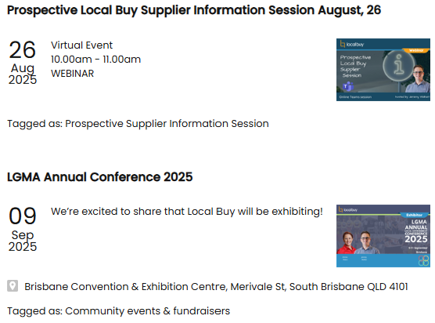
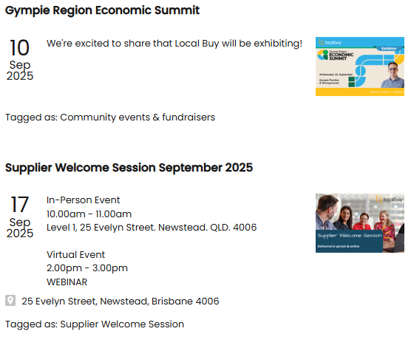

Upcoming events
Advancing Queensland Procurement

Slide 24
Website
Advancing Queensland Procurement
Advancing Queensland Procurement
localbuy.net.au
TENDERS NOW OPEN
1st August to 29th August 2.00pm AEST
Notes:
Visit the events calendar on the LB website.

Slide 25

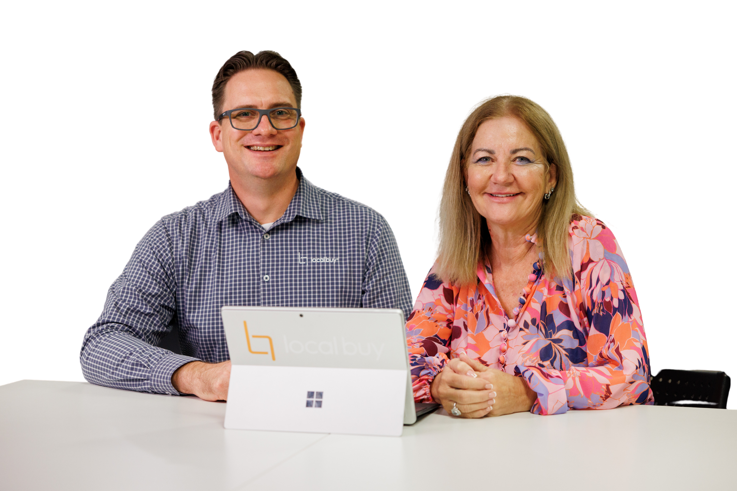




Q&A
ASK AWAY
If you have any questions regarding Local Buy or how you can take advantage of its benefits, feel free to ask our friendly team now.
Alternatively, you can contact our team at any time.
1800 LB HELP (52 4357)
enquiry@localbuy.net.au
www.localbuy.net.au

